Slide 1


Slide 2
BUAN 6337.001 PREDICTIVE ANALYTICS FOR DATA SCIENCE PROJECT-CONAGRA Instructor: PROF. SHERVIN TEHRANI
GROUP 14
Meet Pramod Saraswat | MXS230089
Sai Nikhel Rangala | SXR210183
Chris Espino | ICE190000
Shanvi Shivali Kothapalli | SXK220320
Bhavith Akula | BXA230011
Swati Sutradhar | SXS230225

Slide 3
OVERVIEW
We aim to optimize Conagra's Gardein product portfolio to enhance market share in the growing meat substitute category. With increasing consumer interest in plant-based diets, Gardein seeks to position itself as a leader by refining its flavor offerings, packaging strategies, and market engagement.
Overview of Market and Consumer Trends
Company Background: Conagra, a leading consumer packaged goods company, owns Gardein, its premier meat alternative brand.
Market Growth: Meat substitutes have seen a 11.3% CAGR in USD sales over the past 3 years, driven by ethical, health-conscious, and flexitarian consumers.
Consumer Motivations: Key factors include price, nutritional value, and product attributes such as flavor and texture.

Slide 4
OBJECTIVES
Focus on top-selling flavors to maximize market appeal.
Improve packaging with greener, more sustainable materials.
Line up products with health-oriented and ecologically conscious consumer trends.
Building trust through ingredient and process transparency.
Improved brand identity with innovative marketing strategies.

Slide 5
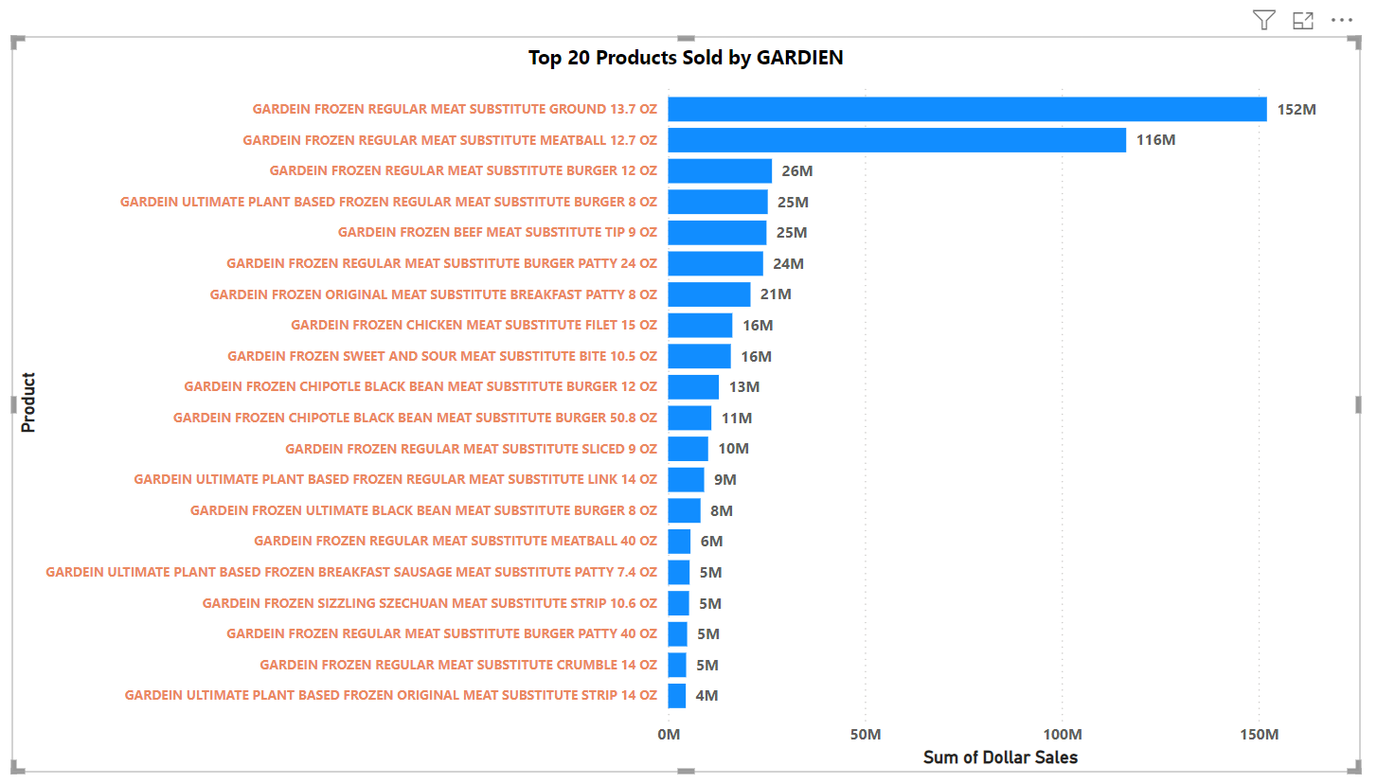
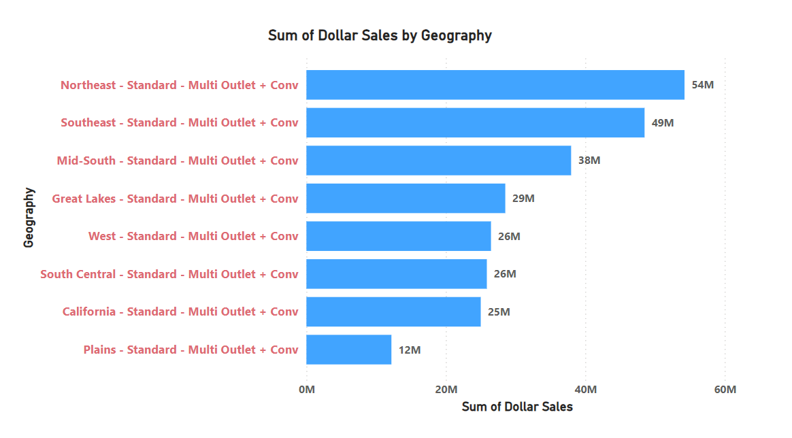
Top 20 Gardein Products by Dollar Sales:
The chart highlights the leading contributors to Gardein's revenue. Products with higher dollar sales reflect consumer preferences for specific flavors, forms, and packaging. These insights can guide targeted production and marketing efforts to maximize profitability.
Dollar Sales by Geography:
The regional breakdown reveals variations in demand across different areas. Regions with higher dollar sales indicate strong market performance and potential for further expansion, while lower-performing regions might benefit from enhanced marketing strategies or tailored product offerings.

Slide 6
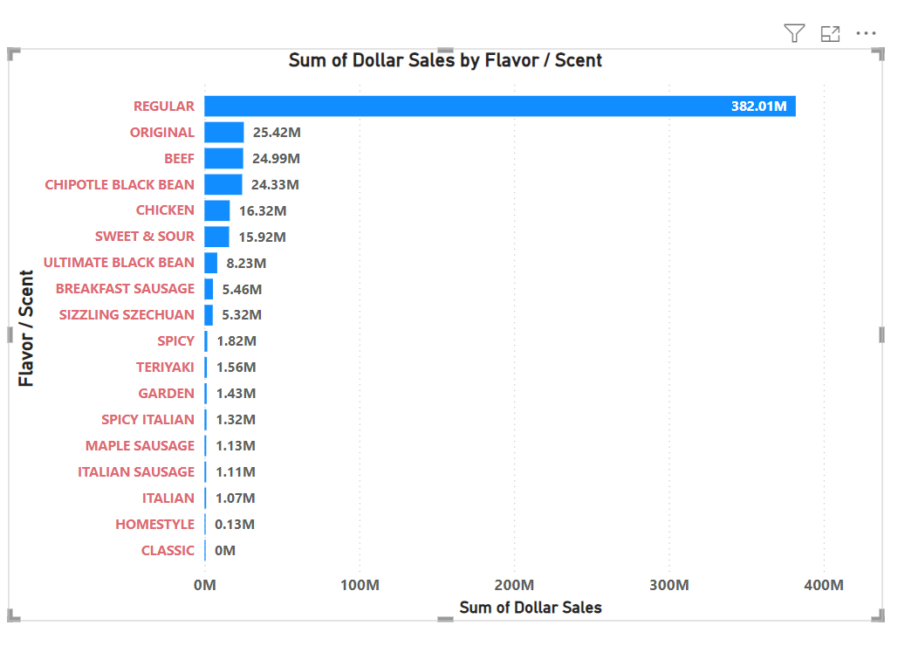
Top-Performing Flavors: The "Regular" flavor is a clear favorite, leading the pack with an impressive $382.01M in sales. Other strong performers like "Original" ($25.42M), "Beef" ($24.99M), and "Chipotle Black Bean" ($24.33M) also show solid consumer appeal and room for even greater success with focused promotion.
Underperforming Flavors: On the flip side, flavors like "Homestyle" ($0.13M) and "Classic" ($0M) haven’t gained much traction with customers. This might mean it’s time to rethink their recipes, reintroduce them with a fresh twist, or phase them out altogether.
Actionable Insights:
Build on the success of top-selling flavors like "Regular," "Original," and "Beef" by ramping up marketing and promotions.
Explore the introduction of new, trend-inspired flavors or regional specialties to keep the lineup exciting and attract new buyers.
Strike a balance between variety and profitability by evaluating underperforming flavors and tailoring the product range to better match consumer preferences.

Slide 7
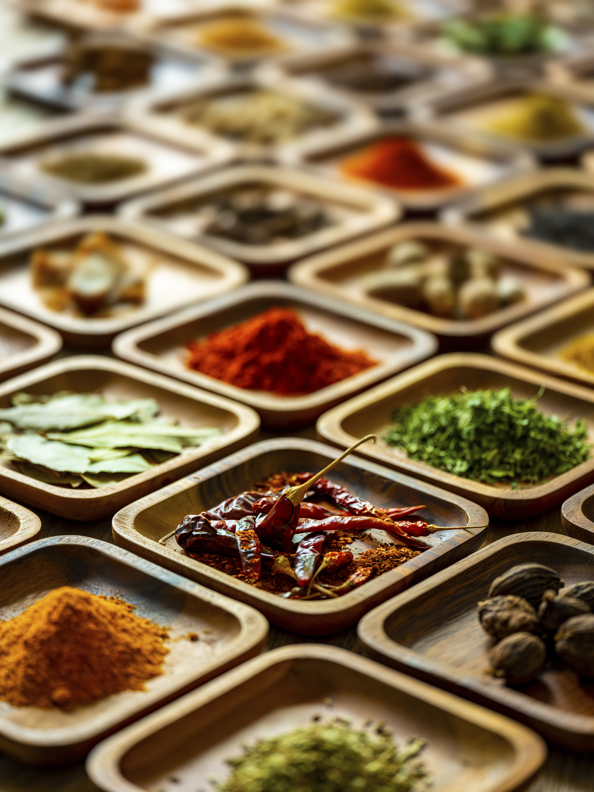
STRATEGIES FOR FLAVOURS
Focus R&D on high-performing products and discontinue underperformers.
Develop clean, mainstream flavors and leverage the clean label trend.
Prioritize familiar flavors like chicken nuggets and experiment with global or seasonal options.
Partner with fast-casual chains to promote top flavors.
Use predictive data to expand into high-demand regions.

Slide 8
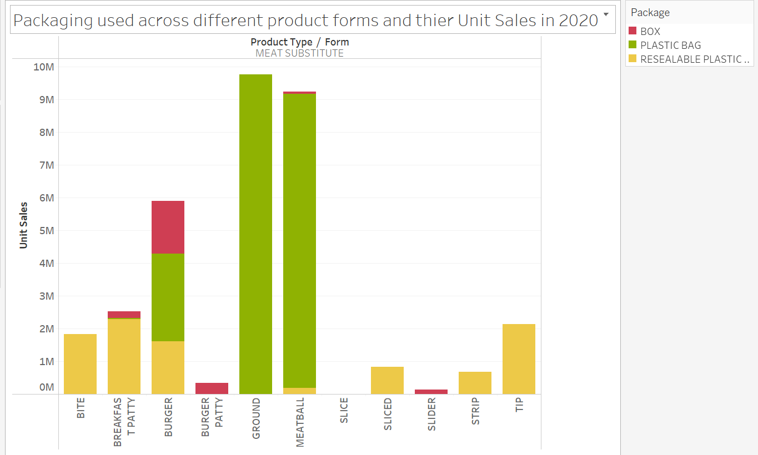
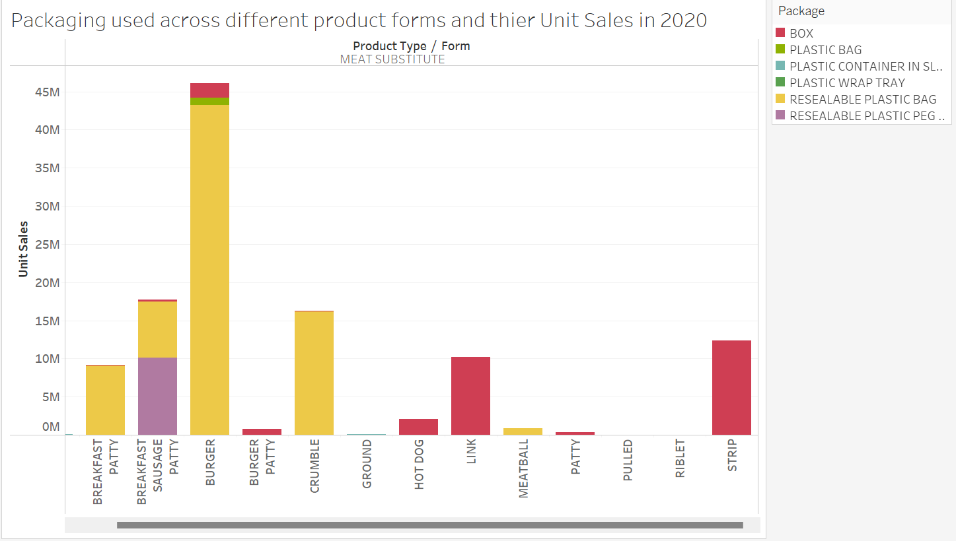
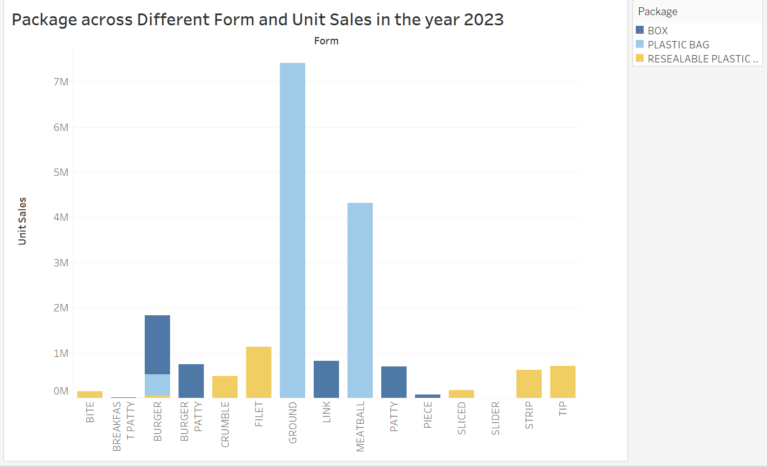
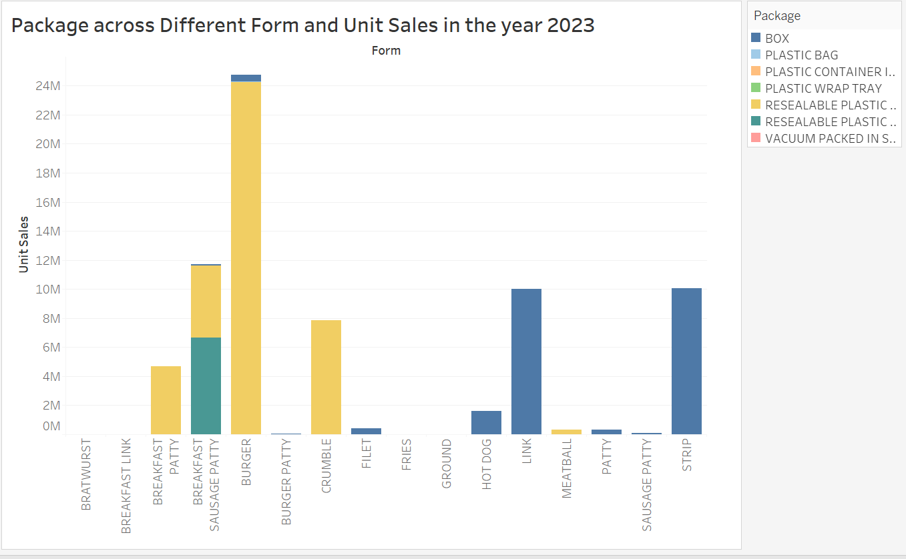
GARDEIN
MORNING STAR
As we can see from the graphs above, from 2020 to 2023, Gardein did not introduce any new packaging and remained with the same three packaging types. Meanwhile, MorningStar already had six different types of packaging in 2020 and expanded to seven by 2023.

Slide 9
Strengths in Packaging:
Weaknesses in Packaging:
Plastic bags versatility:
Affordable and widely accepted across forms.
Resealable plastic bags:
High consumer preference, as it offers long-term potential for premium products.
Overreliance on plastic bags:
Risks alienating sustainability-conscious consumers.
Underutilization of resealable packaging:
Missed opportunities for premium forms like "burger patty".

Slide 10

STRATEGIES FOR PACKAGING
Focus on Resealable Plastic Bags: Prioritize high-performing forms (e.g., "Ground," "Meatball," "Filet") and expand use in "Burger" products.
Introduce Eco-Friendly Packaging: Launch biodegradable resealable bags for premium products and recyclable options for cost-effective forms.
Redesign Box Packaging: Utilize recyclable or compostable materials to enhance eco-conscious appeal and support sustainability objectives.
Develop Marketing Around Packaging: Highlight packaging reliability and sustainability in advertising to build consumer trust.
Tiered Packaging Strategy: Use cost-effective bags for entry-level products and eco-friendly packaging for premium items.

Slide 11
CONCLUSION
Target key consumer groups to drive campaign success and product adoption.
Personalize messaging, build partnerships, and stay ahead of competitors.
Continuously research to refine targeting and uncover new opportunities.
Adapt strategies quickly by monitoring market trends.
Lead the meat substitute market with continuous innovation and exceeding expectations.

